Slide 2
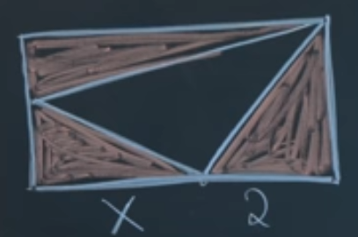
each shaded area is equal, what is x if height of rechtangle is y, the 2*area is 2*y
the width of rechtangle is 2+x
2y/x is the left bottom length
from the top triangle: (y-2y/x)(2+x) = 2y / divide on y and multiple by x
(x-2)(2+x) = 2x
x^2 - 2x- 4 = 0
x = (2 -+sqrt(20))/2 = 1-+sqrt(5)
the length is positive, so 1+swrt(5) is the answer

